Slide 1

Automate all the things!
Scripting made easy
By Nick Ruffilo

Slide 2
Unlocking the secret to learn anything
Who has coded before (besides HTML/CSS)?
Who has a computer science degree?
Who survived algebra?
Who has ever written something before?
Who here struggles with confidence sometimes?

Slide 3
It’s all about the attitude

Slide 4
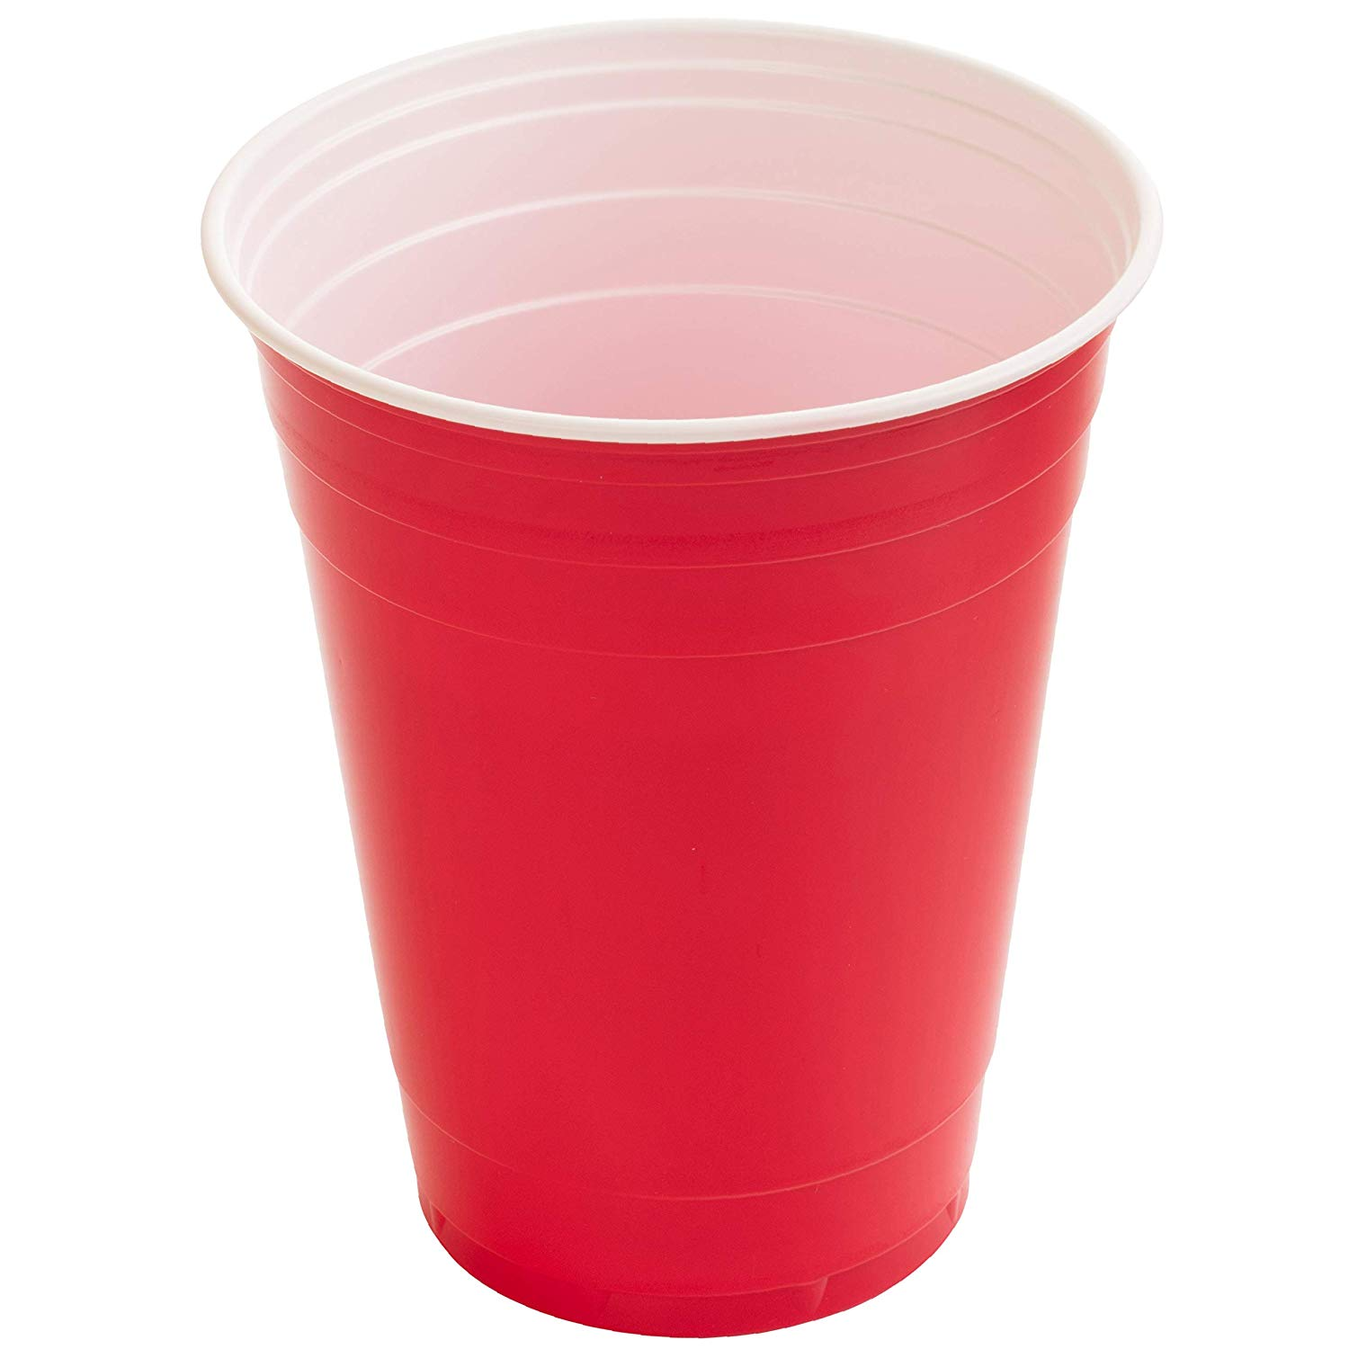
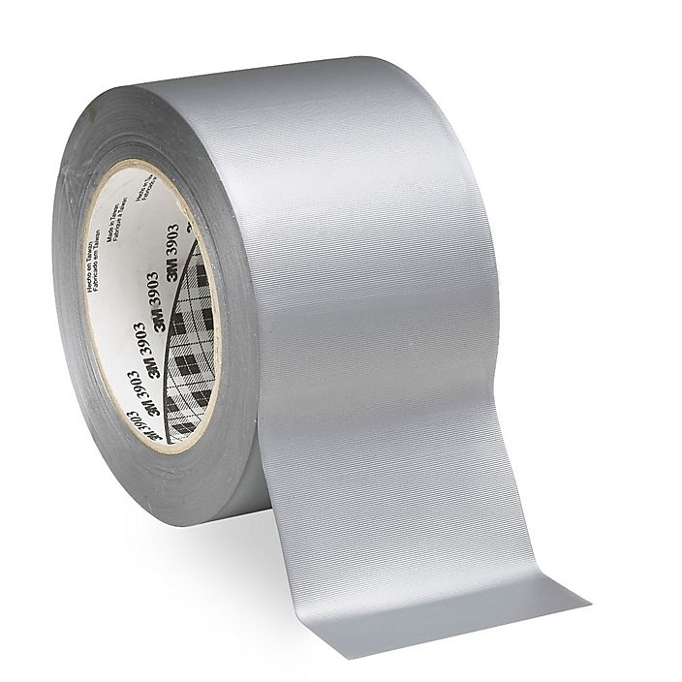
CHALLENGE TIME!
You’re thirsty, but your cup has a hole in it…

Slide 5
There’s not one right way... It doesn’t have to be optimal…
Small piece of tape inverted in the middle of large piece covering the hole
Small piece of tape on the inside of the cup
Small piece of tape on the outside of the cup
Tons of tape reinforcing the tape that is placed going around the entire cup
A new cup made entirely out of duct-tape
Two people working together to overlap the cups for double protection
Drinking straight from the water fountain

Slide 6
If you’ll let me… I can change your life.

Slide 7
The recipe for learning ANYTHING new.

Slide 8
#1 – Want it

Slide 9
#2 - Know it is possible

Slide 10
#3 - Ask 1,000,000 Questions

Slide 11
#4 – Get frustrated, get over it (repeat)

Slide 12
#5 – Break things down

Slide 13
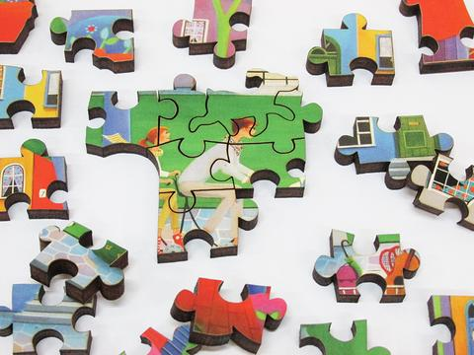
Coding is really problem solving + jigsaw puzzles

Slide 14
Have confidence that you can do it

Slide 15
Don’t do it alone…
Php.net
Me: nickruffilo@gmail.com or @nickruffilo on twitter
The search engine of your choice
A co-worker
Books
Other People’s Code (GitHub, Stack Overflow, etc…)

Slide 16
The truth about coding…
Other Coding Knowledge
Other Coding Knowledge
Other Coding Knowledge
Other Coding Knowledge
Other Coding Knowledge
Other Coding Knowledge
Other Coding Knowledge
My Coding Knowledge
Other Coding Knowledge
Other Coding Knowledge
Other Coding Knowledge
Other Coding Knowledge
Other Coding Knowledge
Other Coding Knowledge
The Internet

Slide 17
A good rule…
If a task is one-off and will take you less than 20 minutes by hand, don’t automate
If a task is repeatable, but will likely takes you less than 5 minutes per week, it’s probably not worth automating
If a task is highly repetitive, it’s usually worth automating
If a task has very specific conditions, it’s likely worth augmenting (hybrid of automating and manual)
Automating something for the first time could take between 10 minutes and 10 hours…

Slide 18
A note on language
Popular Scripting Languages:
PHP
Python
Node (JavaScript)
Ruby / Ruby on Rails (RoR)
It’s like learning a foreign language
Different (but similar) grammar
Different words
Significantly smaller vocabulary (50? Total keyword/functions/variable types)

Slide 19
Installation
PHP On Mac – Comes preinstalled (version 5.2 – a bit old, but still great)
Windows: https://windows.php.net/download#php-7.3
http://kizu514.com/blog/install-php7-and-composer-on-windows-10/
Python on Mac: https://docs.python-guide.org/starting/install3/osx/
Python on Windows: https://www.python.org/downloads/windows/
Image Magick: https://imagemagick.org/script/download.php

Slide 20
Here’s some pieces that’ll get you started…
Reading & Writing to Files
Running Commands
Basics of Variables
Find and Replace

Slide 21
Lets get coding!

